Slide 1
EXHIBIT A-Aerial View Mandarin Boat Ramp

Slide 2
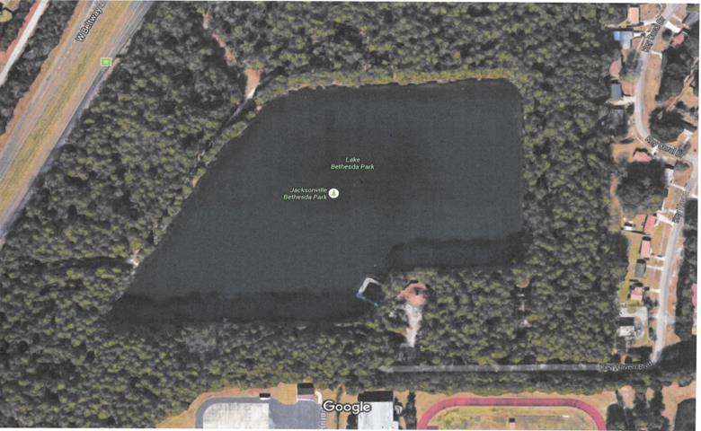
EXHIBIT B

Slide 3
EXHIBIT B

Slide 4
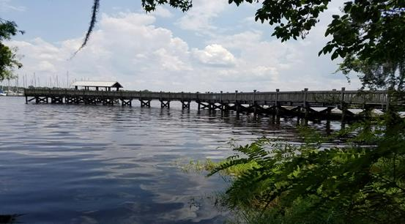
EXHIBIT C
View of river from existing kayak launch on shoreline facing south

Slide 5
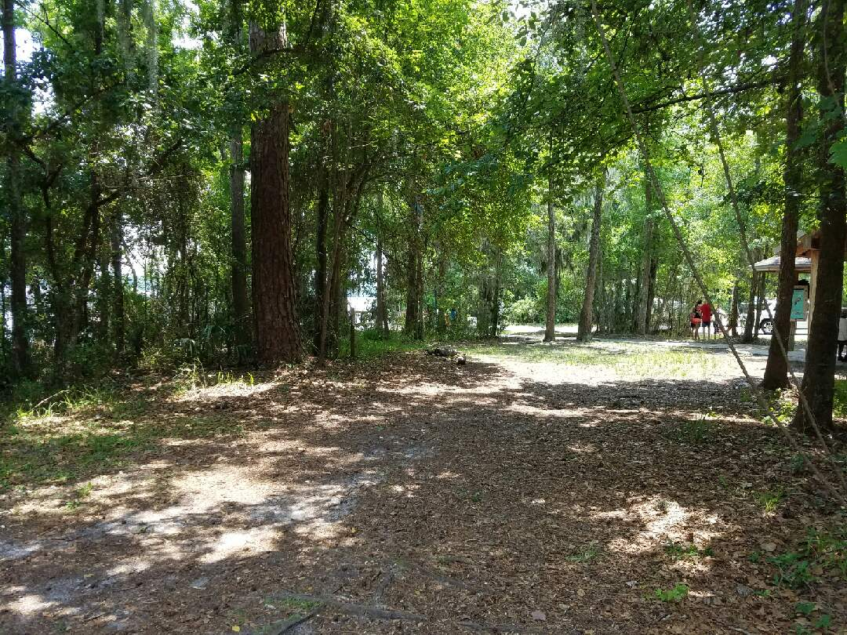
EXHIBIT C
View of entrance of existing launch looking west towards boat ramp

Slide 6
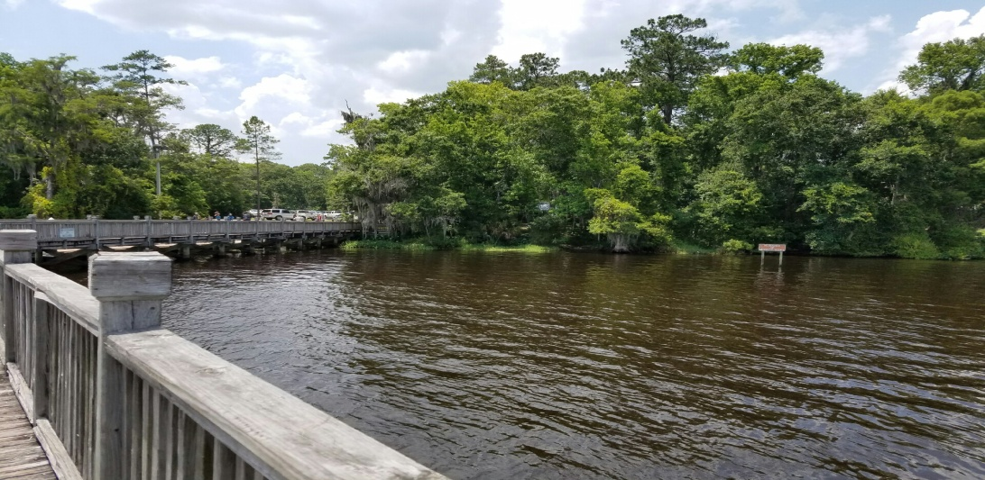
EXHIBIT C
View of existing shoreline launch from dock looking north

Slide 7
EXHIBIT D-Kayakers on Port

Slide 8
EXHIBIT E-Kayakers on Ramp

Slide 9
EXHIBIT F
Examples of Sailboats

